Slide 1


A more fluid way to model time-series data
IBM Research • Applied Machine Learning with Text Analysis • 2025

Slide 2

Understanding Time-Series Data
Time-series data captures how values change over time—from stock prices and weather patterns to website traffic and sensor readings. This sequential data is everywhere in our digital world.
Accurate forecasting helps businesses make informed decisions, optimize resources, and anticipate future trends. The challenge lies in capturing both short-term fluctuations and long-term patterns effectively.

Slide 3
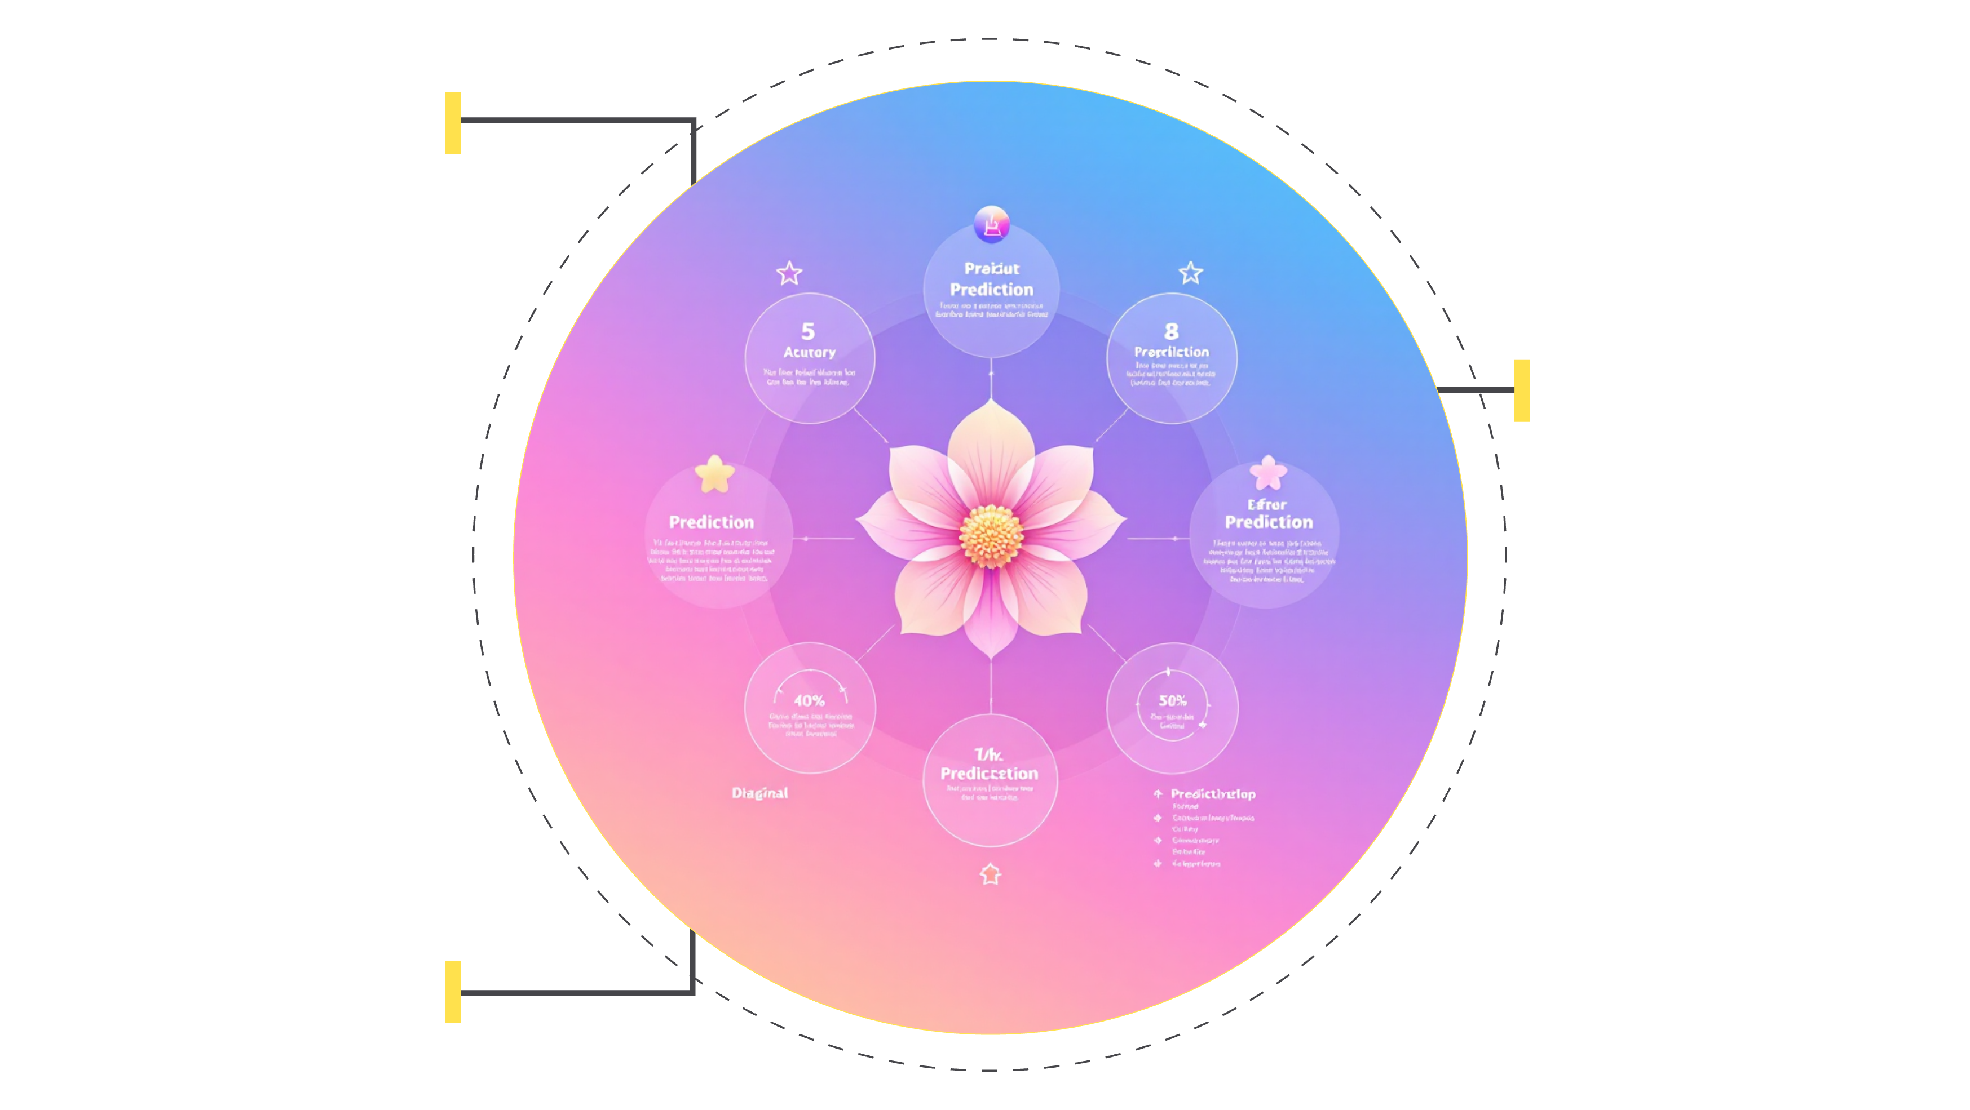
The Forecasting Challenge
Multiple Timescales
Hourly, daily, weekly forecasts
Complex Patterns
Seasonality and nonlinearity
Computational Cost
Scaling models and resources

Slide 4
Introducing FlowState
IBM Research developed FlowState as a state-space model that flexibly handles multiple forecasting timescales within a single framework. Unlike traditional approaches, FlowState can generate predictions at any desired horizon without retraining.
01
02
03
State-Space Architecture
Single Training Cycle
Adaptive Predictions
Built on continuous-time dynamics for flexible temporal modeling
One model learns patterns across all timescales simultaneously
Generate forecasts at any future time point on demand

Slide 5
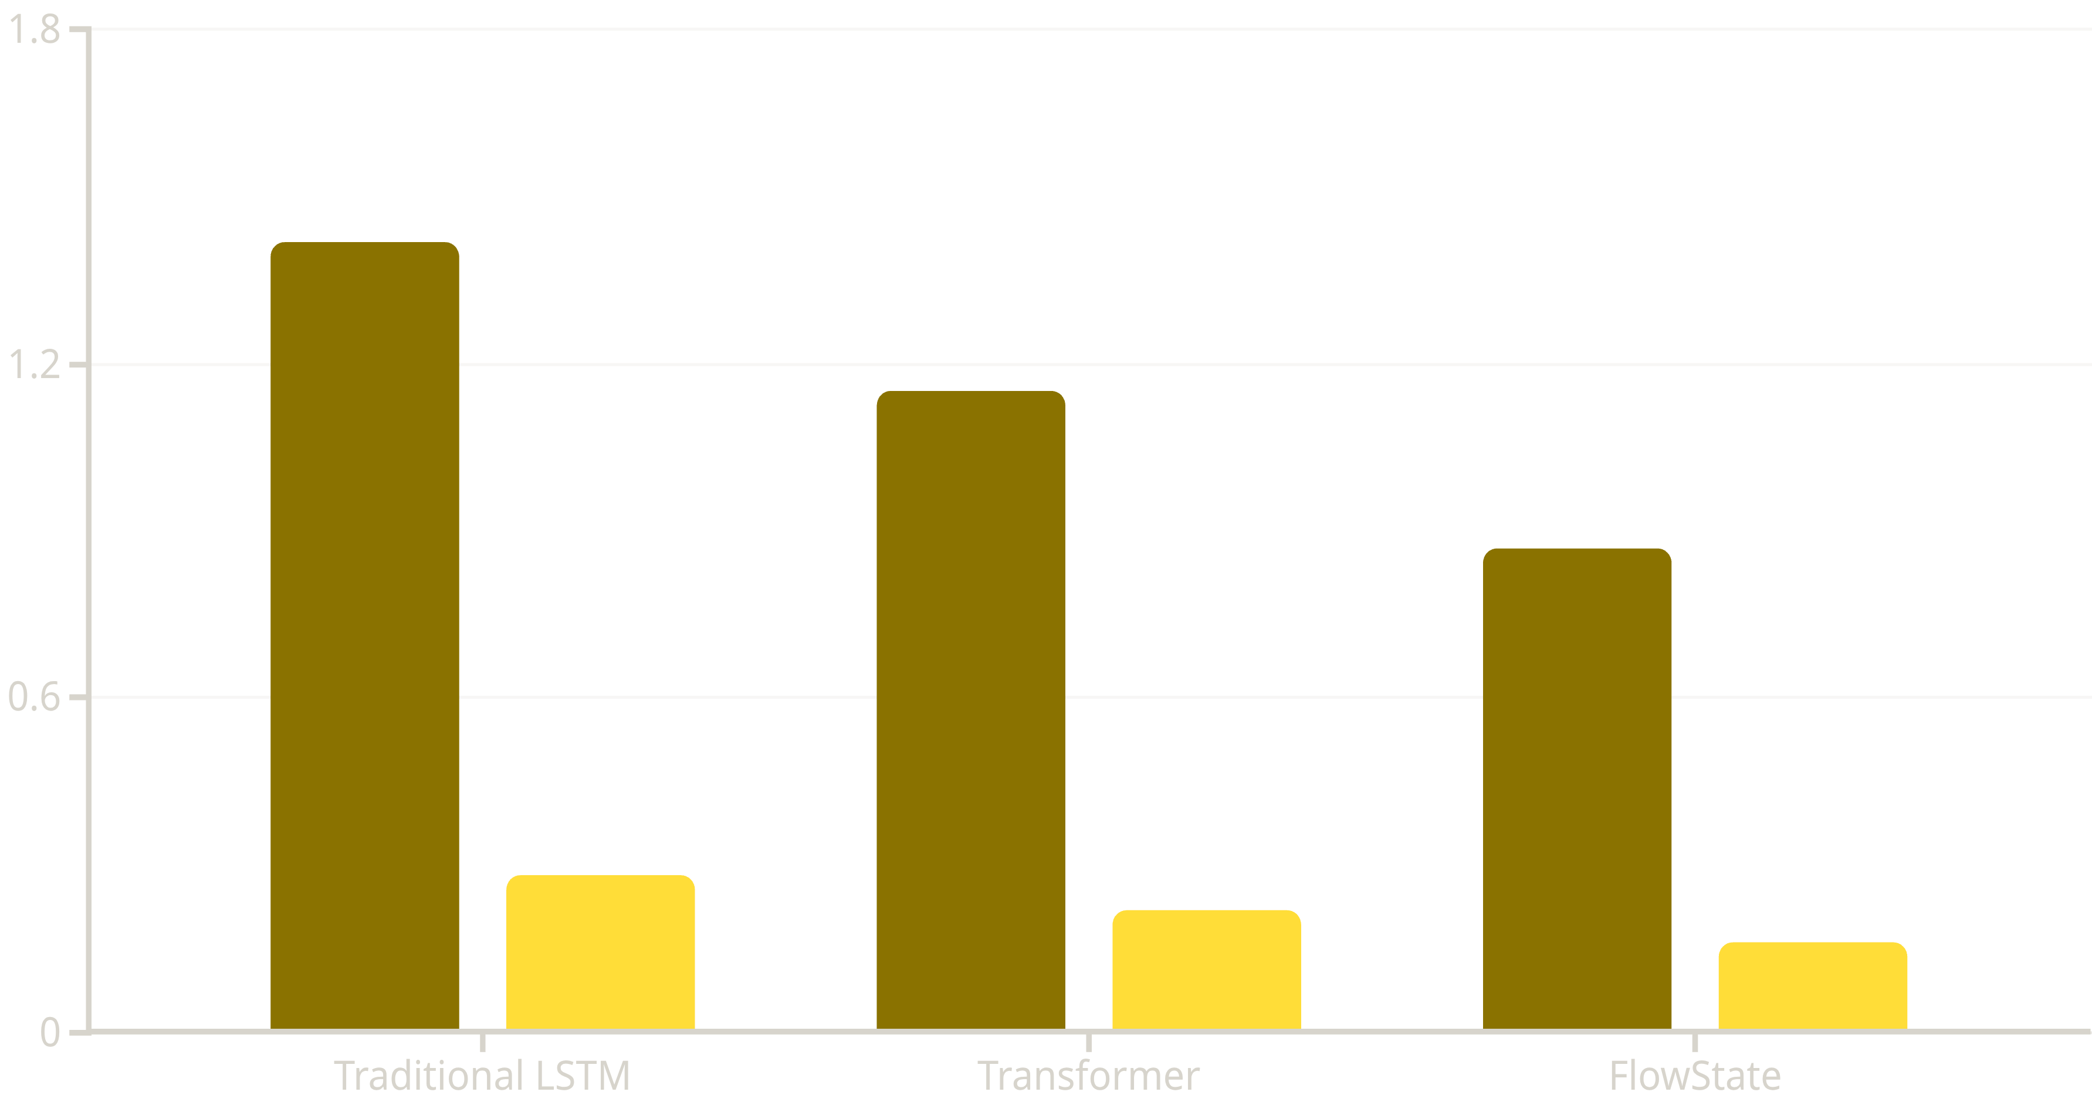
Performance Benchmarks
FlowState was evaluated using the GIFT-Eval benchmark across diverse real-world datasets. Results demonstrate superior accuracy and efficiency compared to existing methods.
MASE Score
CRPS Score
Lower scores indicate better performance. MASE measures point forecast accuracy; CRPS evaluates probabilistic forecast quality.

Slide 6
Real-World Applications
Traffic Forecasting
Sales Prediction
Web Traffic Analysis
Predicting congestion patterns at different time horizons helps optimize routing and reduce travel times.
Retailers forecast demand at multiple timescales to manage inventory and staffing efficiently.
Websites predict user activity patterns to scale infrastructure and improve user experience.

Slide 7
Key Advantages
Flexibility
Efficiency
Accuracy
Single model handles forecasting at any timescale—from minutes to months—without retraining or architecture changes.
Reduces computational costs by eliminating the need for multiple specialized models for different prediction horizons.
State-space dynamics capture complex temporal dependencies more effectively than traditional recurrent architectures.

Slide 8
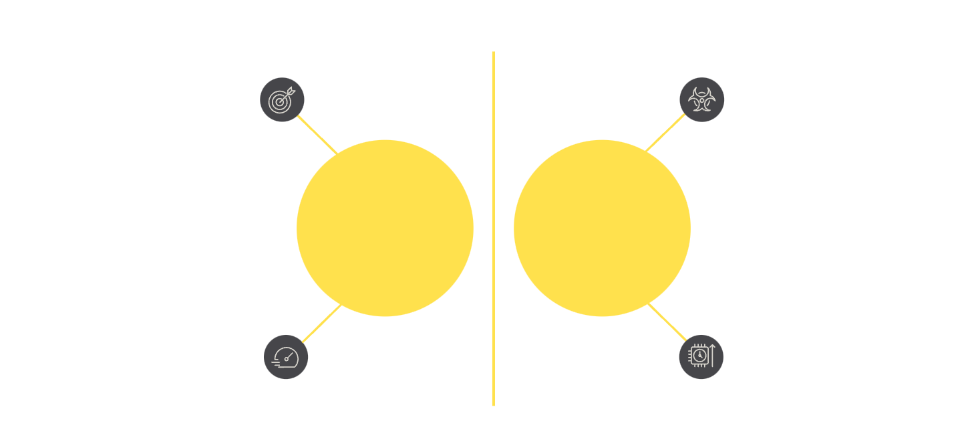




Conclusion & Future Directions
Key Takeaways
FlowState provides a unified framework for multi-horizon time-series forecasting
Higher accuracy
Lower accuracy
State-space models offer flexibility and efficiency over traditional approaches
FlowState
Traditional
Faster inference
Slower compute
Benchmark results show significant improvements in both accuracy and computational cost
Applications span diverse domains from transportation to e-commerce
Future Potential
As time-series data continues to grow in volume and complexity, flexible models like FlowState will become increasingly valuable for real-time decision-making across industries.

Slide 9
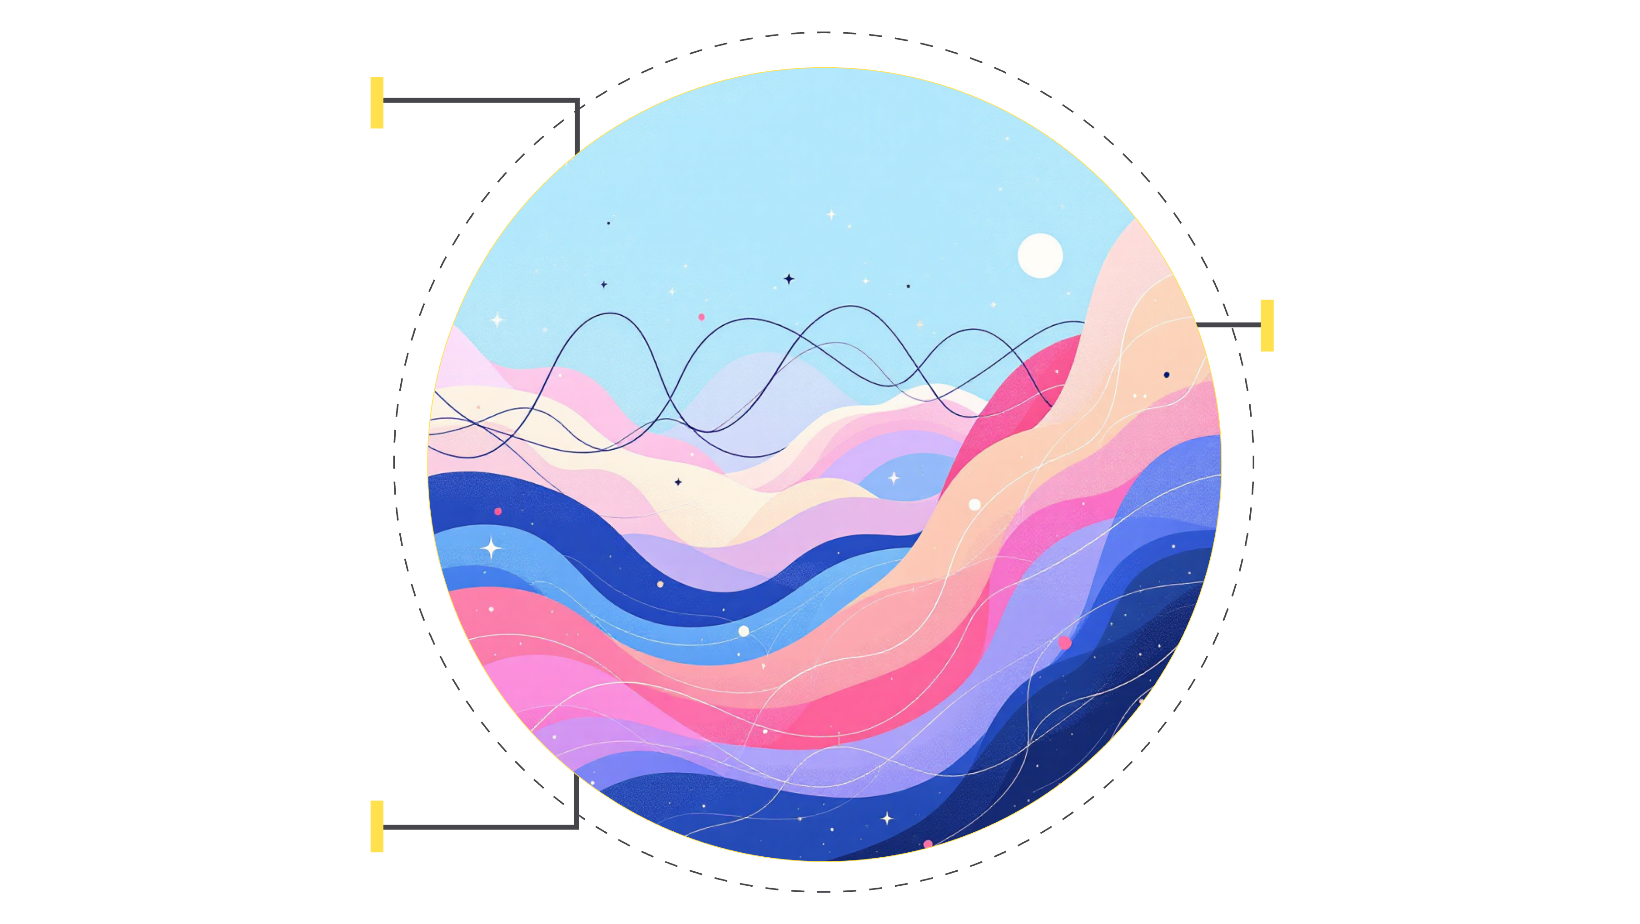
References
Primary Source
Benchmark Dataset
Conference
IBM Research FlowState: State-Space Models for Flexible Time-Series Forecasting (2025)
GIFT-Eval: General Time-Series Forecasting Evaluation Framework
Presented at NeurIPS 2025 (Neural Information Processing Systems)
IBM Research
Primary source of FlowState
GIFT-Eval
Benchmark dataset for evaluation
NeurIPS 2025
Conference presentation venue
For more information, visit IBM Research publications or access the paper through the NeurIPS 2025 proceedings.

